Slide 1
CAPSTONE II Presentation
Gas Sensor
Analysis
By: Alejandro Moore
Notes:
Hello! My name is Alejandro Moore, and I will be presenting on the analysis of Gas Sensors. For the project my team is working on, sensors are a crucial part that can measure what we want to observe.

Slide 2
What’s the purpose?
Sensor
Device that has the capability to detect change in its surrounding environment and provides output in the form of analog or digital signal.
Sends its data through transmitter to the microcontroller/microprocessor.
Single Gas Detector
Multi-Gas Detector
Hand-held, portable devices used to monitor one target gas.
Commonly part of PPE for identification of a hazardous gas.
Ability to monitor multiple target gases.
Used in industrial and residential settings to locate the presence of a variety of dangerous gases.
Notes:
What's the purpose? A sensor is a device that has the capability to detect change in its surrounding environment and provides output in the form of analog or digital signal. It can act as the eyes, ears, hands, and even nose of the system to tell the microcontroller what it wants to know. Sensors are able to send its data through transmitter to the microcontroller/microprocessor. 2 types of detectors are seen to show what they are used for. Single Gas Detectors are normally hand-held devices that monitor 1 target gas. Mostly used for PPE (Personal Protective Equipment) to identify hazardous gases. Multi-Gas Detectors are able to identify several gases that are present. They are normally used for industrial or residential areas that are known to produce a variety of dangerous gases.

Slide 3
Did you know?
There are 4 main types of gas sensors?
Photoionization Sensors
Infrared Sensors
Electrochemical Sensors
Catalytic Sensors
Notes:
Did you know that there are 4 main types of Gas Sensors in stores today? They can be classified as Infrared, Catalytic, Photoionization, and ElectroChemical sensors.

Slide 4
We will talk about this first.
01
Infrared Sensors
Notes:
Firstly, we will start with Infrared Sensors.

Slide 5
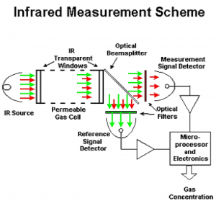
Infrared Sensors
a method for detecting combustible hydrocarbon gas with infrared light.
Used when there is no oxygen present, or in situations where you measure high carbon dioxide concentrations.
Infrared source illuminates a volume of gas that has entered inside the measurement chamber.
Gas absorbs some of the infrared wavelengths as the light passes through it, while others pass through it completely unattenuated.
A change in the intensity of the absorbed light is measured relative to the intensity of light at a non-absorbed wavelength.
Infrared gas detection devices may be classified as open path detection or point detection.
Notes:
The microprocessor computes and reports the gas concentration from the absorption. When there is no gas present the signals of reference signal detector and measurement signal detector are balanced. Inversely, when there is combustible gas present, there is a predictable drop in the output from measurement signal detector because the gas is absorbing light. Also, there are 2 different classifications to Infrared gas detectors. Open path detectors include separate transmitters and receivers that measure the presence of gas between the two points up to 200 meters apart. Point detectors measure the amount of gas present at a fixed location. In most cases, a combination of open path and point detectors can be combined to provide the highest level of safety.

Slide 6
Pros & Cons
Advantages
Disadvantages
Speed of response is very quick, typically less than 10 seconds.
Immune to contamination and ''poisoning''.
Practically fail-safe, since any failure of the source or detector, or blockage of the signal by dirt, is immediately detected as a malfunction.
Able to operate reliable in oxygen-rich or oxygen-poor environments.
Virtually maintenance free and good for inaccessible areas.
Higher initial cost.
Unable to detect gases that do not absorb infrared energy (ex. Hydrogen).
Infrared emitting source can not be repaired in the field and must be returned to factory.
Notes:
There are various pros and cons to the Infrared Gas sensor. To start, the advantages are pretty convincing. A quick speed response is useful depending on the type of system one uses these sensors with. And it is less hazardous to people when it comes to contamination or silicon poisoning when it comes to other types of sensors. Another reason why IR sensors are preferred is because the sensor can detect a malfunction and fix itself using both the measurement and reference signals. Its compatibility with most environments gives it an edge using the right classification of open path or point detectors. Some of the disadvantages would be the cost, and the sensors lack of detecting gases that don’t absorb oxygen, such as hydrogen. In general, gas sensor prices have a substantial range. I believe one of the main factors of this is what kind of components are integrated into the PCBs and the methods of measuring the prarmater of choice for the sensor. Lastly, a IR sensor in need of repair must be sent back to the factory or manufacturer which most likely is not preferred for companies that want to consistently use a specific detector.

Slide 7
We will talk about this next.
02
Catalytic Sensors
Notes:
Secondly, we will look at Catalytic sensors next.

Slide 8
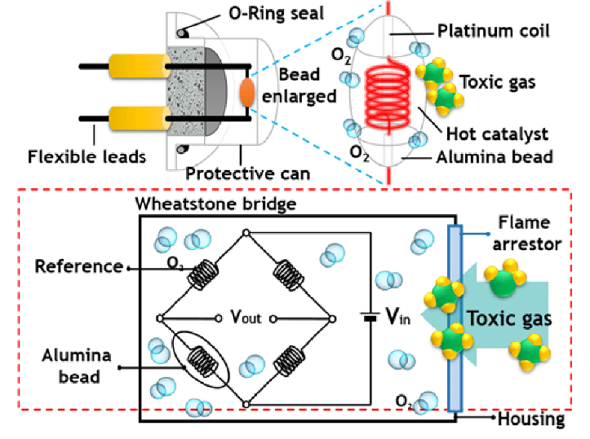
Catalytic Sensors
Typically used to measure combustible gases that come with an explosion hazard when concentrations are between the lower explosion limit (LEL) and the upper explosion limit (UEL).
2 basic elements: a detector which contains a catalytic material sensitive to flammable gases, and a compensator element which is inert.
Combustible gases will burn in the presence of oxygen only on the detector, causing a rise in temperature and a corresponding rise in electrical resistance, and the sensor will convert the temperature change via a Wheatstone bridge-type circuit.
When combustible gases raise the temperature of the detector and a rise in its resistance, it causes an imbalance in the circuit and produces an output voltage signal.
Notes:
Catalytic Sensors function differently from IR Sensors. It is normally used to measure combustible gases whose concentrations are between the lower explosion limit (LEL) and the upper explosion limit (UEL). This is done by using 2 basic elements. Firstly, a catalytic material that is sensitive to flammable gases and a compensator element which is inert. When oxygen is present, the combustible gas will burn causing a temperature increase. This change in tandem causes a change in electrical resistance as seen with the Alumina bead in the picture. This resistor is connected to a Wheatstone Bridge- type circuit which outputs a voltage based on the change of resistance of both the reference and catalyst resistors.

Slide 9
Pros & Cons
Advantages
Disadvantages
Easy to install, use, and calibrate.
Economical, with a long life and low replacement cost.
Very reliable.
Can be calibrated to gases such as hydrogen.
Not sensitive to optics and perform more reliable in dusty environments.
More reliable in high temperature
Less sensitive to humidity and changes in air
Can become inactive through contamination by chemicals containing chlorine and silicone compounds, as well as sulfuric and other corrosive chemicals.
The only means of testing sensors is to expose them to known quantities of gas and calibrate them as needed.
Requires oxygen to operate.
Long exposure to concentrated hydrocarbons may degrade performance.
If subjected to extreme gas concentration, the sensor may become damaged and show low or no signal.
Notes:
Looking at the pros of a catalytic gas sensor, they are not only cheap, but easy to install, use and calibrate. These sensors have a long life expectancy and are quite reliable to give the microcontroller what it is asking for. Catalytic detectors are also able to detect hydrogen and other gases that are not able to absorb infrared radiation. Another advantage is that this sensor doesn't care if there was a tornado throwing debris or a sandstorm because the optical requirements are not needed. This sensor can disregard any change in the air like humidity, and is more reliable in higher temperature. Even with all these advantages, there are some setbacks of note. Catalytic sensors can become inactive through contamination from corrosive chemicals and compounds that it may detect. If the user wanted to test this type of sensor, it must be exposed to the known quantities in order to calibrate properly. Also, oxygen must be present in order for these sensors to detect the gas present. And if there is is found at the detector an extreme gas concentration, the sensor may become damaged and show little to no output signal. One must take into account these pros and cons before thinking of using it as part of their project.

Slide 10
We will talk about this next.
03
Photoionization Sensors
Notes:
Next, we have Photoionization Sensors.

Slide 11
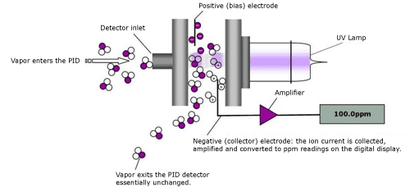
Photoionization Sensors
Uses an ultraviolet light source to ionise gases to positive and negative ions that can easily be identified with a detector.
Charge of the ionized gas functions as the concentration of volatile organic compounds (VOC) in the air.
Most VOCs are detected by these sensors, expect for low molecular weight hydrocarbons.
UV lamp generates high-energy photons that pass through these lamps into the central chamber of the sensor.
The gas sample in the atmosphere passes over into the sensor chamber and one percent of it diffuses through a membrane filter.
Device then generates a current that’s proportional to a gas concentration displayed as a ppm or ppb (Parts Per Billion).
Notes:
Photoionization Sensors have a unique functionality to detect the gases present. The sensor uses an ultraviolet light source to ionize gases into positive and negative ions that can be identified with a detector. These newly charged ionized gas functions as the concentration of volatile organic compounds (VOC) in the air. A majority of VOCs are detectable by Photoionization Sensors, except for low molecular weight hydrocarbons. Within the device, a UV lamp is found that generates high-energy photons that pass through these lamps into the central chamber of the sensor. A sample of gas in the atmosphere passes through the detector inlet into the sensor chamber and 1% of the gas present in the chamber diffuses through a membrane filter. The device then generates a current that is proportional to a gas concentration displayed as a value in ppm or ppb.

Slide 12
Pros & Cons
Advantages
Disadvantages
Cost-effective.
Simple to use and easy to install.
Able to provide almost instantaneous results.
Able to detect low concentrations of VOCs.
Not suitable for the detection of semi-volatile compounds.
May give false positive readings for water vapor and rain. Also, high humidity can cause lamp fogging and decreased sensitivity.
High concentrations of methane can hinder performance.
Rapid variations in temperature at the detector, strong electrical fields, and naturally occurring compounds may affect instrument response.
Must be re-calibrated frequently.
Notes:
These are the advantages and disadvantages of the photoionization gas sensor. As you can see, this type of gas sensor is not only cost effective, easy to use and install. But also provides almost instantaneous results and is able to detect low concentrations of VOCs which can save lives if not noticed. Some of the drawbacks on this sensor are important to know as well. This sensor is not suitable for semi-volatile compound detection, and when present in high concentrations of methane, it can hinder the performance of the sensor. Depending on the humidity, there may be fogging in the lamp, decreased sensitivity, and even false positive readings from water vapor and rain. At the end of the day, photoionized gas sensors can be quite fragile because the instrument response can be affected by rapid variations in temperature, strong electrical fields, and naturally occurring compounds. From what I have researched, these types of sensors are used on PPE for employees who work around hazardous spills, gases, oil, etc.

Slide 13
Lastly, we will talk about this.
04
Electrochemical Sensors
Notes:
Lastly, we will see how Electrochemical sensors work.

Slide 14
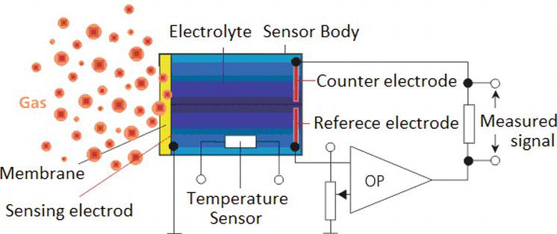
Electrochemical Sensors
Measure a specific gas concentration by oxidising or reducing the gas to an electrode, generating a positive or negative current flow.
Membrane allows gas to pass into the sensor, which in turn can either create oxidation or reduction.
The electrical current generated is proportional to the concentration of the target gas.
Current is then amplified and processed according to the calibration to give the user a reading in either parts per million (PPM) or percentage volume.
To avoid cross-sensitivity, it is important to use filters and biasing voltage during operations to minimize the effect on the accuracy.
Notes:
This is the functionality of an electrochemical gas sensor. They are typically used to measure the concentration of a target gas within an external circuit and measure a specific gas’s concentration by oxidising or reducing the gas to an electrode, generating a positive or negative current flow. As you can see in the diagram, the devices generally consist of a working/sensing electrode, counter, and reference electrode, all of which are contained within a housing with a gas-permeable membrane. When a gas goes past the sensing electrode, a reaction occurs of either 2 cases. These reactions initiate a flow of electrons (i.e., current) between the sensing electrode and counter electrode. An oxidation reaction moves electrons from the working electrode to the counter electrode, while a reduction reaction causes electrons to move from the counter electrode to the working electrode. In either case, the electrical current generated is proportional to the concentration of the target gas. Using the following circuit, the current is then amplified and processed to give the user a value in ppm or percentage volume. Another fact about electrochemical sensors is the phenomenon of cross-sensitivity. This refers to the response of the sensor to gases other than the target gas, generally as a result of greater chemical reactivity in the non-target gas than the target gas. To avoid this error, it is important to use filter and bias voltage during operation to minimize the effect on the accuracy of the data.

Slide 15
Pros & Cons
Advantages
Disadvantages
Linear output, low power requirements and good resolution.
Excellent repeatability and accuracy.
Does not get poisoned by other gases.
Less expensive than most other gas detection technologies.
Narrow or limited temperature range.
Short or limited shelf life.
Cross-sensitivity of other gases.
The greater the exposure to the target gas, the shorter the life-span.
Notes:
The advantages and disadvantages of the electrochemical sensors are shown. Linear output makes the sensor data easier to calibrate and process for an electrical system. The use of low power gives the entire system that the sensor is a part of a lesser load for consistent power and production, and the resolution is important for data analysis. Also, these sensors are designed to be repeated and accurate so the use for these types of sensors are more preferred. The user does not have to worry about the presence of other ambient vapors, because it won’t shorten or curtail the life of the sensor. Also, unlike infrared and PID technologies, electrochemical sensors are economical. Some disadvantages that should be noted is not only the cross-sensitivity, but also the temperature range. They are sensitive to temperature and, therefore, the sensors typically are internally temperature compensated. Depending on the gas to be detected and the environment, an electrochemical sensor usually has a shelf life of six months to one year. Lastly, low humidity and high temperatures can cause the sensors’ electrolyte to dry out. Exposure to target gas or cross-sensitivity gases also depletes the electrolyte. This are good things to know when looking for a sensor that suits your purposes of a project or device.

Slide 16
Overview
Each sensor has its own strength and weakness.
User must take into account cost, accuracy, resolution, life-span, and many other factors before knowing which sensor will complete the task successfully.
For the Citizen Air Quality Sensor, we will use Electrochemical Gas Sensors to meet the requirements in our Project Proposal.
Thank You!
Notes:
To summarize, all these different types of gas sensors have their own edge and drawback depending on the instruments used and what job needs to be done. For my project, most of the sensors I have selected for our Citizen Air Quality sensor are Electrochemical Gas Sensors. Not only because of their low cost of cost, but also because if its reliability and simple configuration to work with the microcontroller. Photoionization, Infrared, and Catalytic Sensors have their strengths, but most are too expensive are are not compatible in most types of environments. Therefore, the project our team is responsible for this course will be executed using electrochemical sensors for its first trials. I hope you have learned something about ags sensors in the presentation, thank you!

Slide 17
References
NewCastle Saftey Servicing https://newcastlesafetyservicing.com/types-of-gas-detectors/#:~:text=In%20this%20article%2C%20we'll,infrared%20sensors%20and%20photoionization%20sensors.
Gas and Flame Detection https://www.gdscorp.com/infrared-gas-detectors/#:~:text=Infrared%20gas%20detection%20is%20a,and%20an%20optical%20infrared%20receiver.
EnggCyclopedia https://enggcyclopedia.com/2011/11/infrared-gas-detectors/
Technical Services https://www.buygasmonitors.com/blog/a-comprehensive-overview-to-photoionization-detectors/
Photo Ionization Detector http://www.cpeo.org/techtree/ttdescript/photion.htm#:~:text=Limitations%20and%20Concerns&text=The%20PID%20may%20give%20false,lamp%20fogging%20and%20decreased%20sensitivity
RC Systems https://www.rcsystemsco.com/photoionization-detectors#:~:text=Advantages%20of%20Photoionization%20Detectors,and%20other%20emergency%20leak%20situations.
Safety+Health https://www.safetyandhealthmagazine.com/articles/the-pros-and-cons-of-electrochemical-sensors-2
Notes:
Here are my references, let me know if you have any questions!

